Slide 1
DSP Final Project
劉義瑋
Blueswen Liu

Slide 2


KAMERA Emergency Medicine Challenge
http://dc.dsp.im/main/content/KAMERA-Emergency-Medicine-Challenge

Slide 3
KAMERA
高屏緊急醫療應變聯盟
Kaoping Area Medical Emergency Response Alliance
KAMERA established in 2010. They want to combine the resources of hospital with first-aid capabilities and pre-hospital care to supply real time resource matching and support decision optimization. Main service area is the Kaoping area now, but in the future they want to expand to other area.
Notes:
英文單字參考
http://blog.xuite.net/alan20334/wretch/91487645-%E6%95%91%E8%AD%B7%E7%9B%B8%E9%97%9C%E5%B0%88%E7%94%A8%E5%90%8D%E8%A9%9E%E4%B9%8B%E4%B8%AD%E3%80%81%E8%8B%B1%E6%96%87%E5%B0%8D%E7%85%A7%E8%A1%A8

Slide 4
KAMERA
高屏緊急醫療應變聯盟
Kaoping Area Medical Emergency Response Alliance
此計畫為2010開始發展進行之緊急醫療資訊整合方案，主旨在結合急救責任醫院與到院前救護端資源，提供即時資源媒合與輔助決策優化。目前主要服務區域為大高屏地區，未來計畫延伸擴展服務區域。

Slide 5
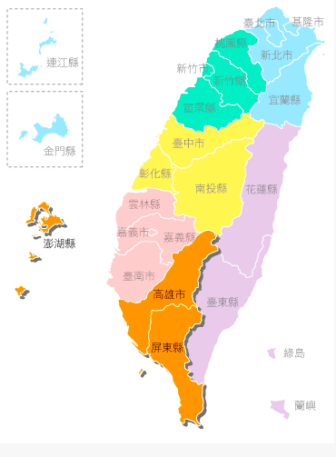


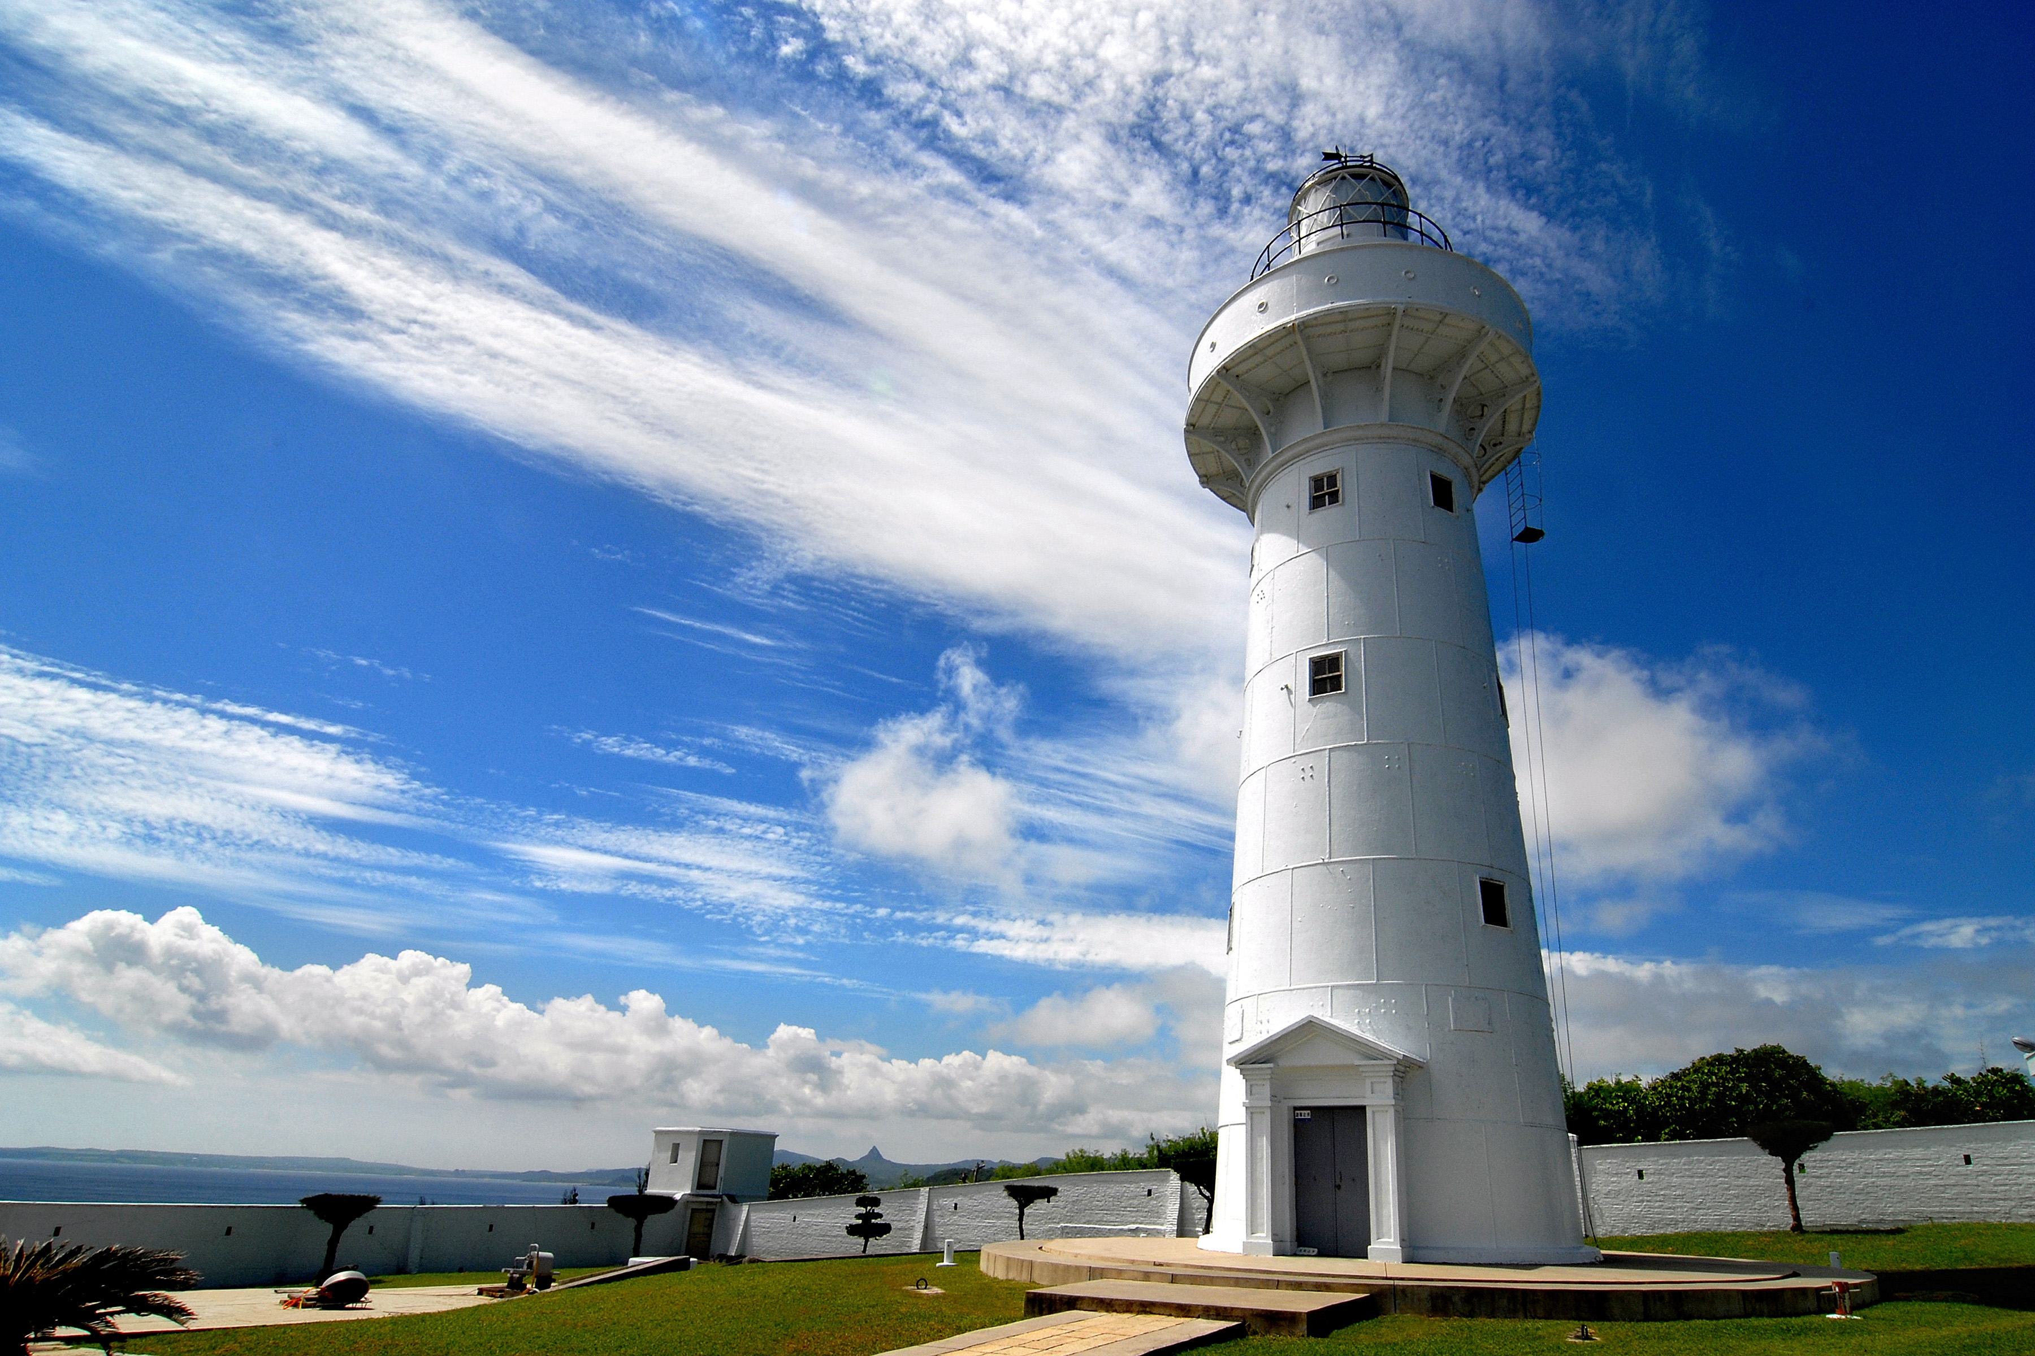
Penghu
Kaohsiung
Pingtung
Notes:
85
鵝鑾鼻燈塔
雙心石滬

Slide 6
Background
Emergency department congestion is representative of a dysfunctional system
There are many reasons, like the abusing of emergency medicine resource or dysfunctional information system
KAMERA developed a trans-hospital emergency department congestion real time surveillance system. KAMERA provide some historical data from this system, and they hope they can move from surveillance to prediction.

Slide 7
Background
急診雍塞是系統失能的表現
原因眾多，如急診資源的濫用問題、資訊聯繫失能
過去 KAMERA 針對這個議題，開發了跨院急診壅塞即時監視系統，為了讓這個系統能有更進一步的運用，KAMERA 提供了部分的歷史資料，希望從被動的急診壅塞監測轉為更為主動的急診壅塞預測

Slide 8
Data
Part of KAMERA’s partners’ emergency department’s operating data
Data Time: 2013/01/01 ~ 2013/12/31
Number of Hospitals : 11
Records: 21364 records
Fields: 37 fields

Slide 9
Data
資料範圍為 2013.01.01 至 2013.12.31 期間， KAMERA 體系內部分醫院的急診部門營運數據。
11所醫院(1,6,11,12,13,14,16,17,22,35,40)
21364 records, 37 fields

Slide 10
Data
date | date of record
tz | time of record [1]
Hospital_PK | code of hospital
Level | level of hospital [2]
PDR | patient doctor ratio
PBR | patient bed ratio
total | total of all triage level
Light | emergency department congestion light
A01~A03 | number of visits of Med., Surg., Ped. | A15 | number of waiting bed of EM
A04~A06 | waiting lists of Med., Surg., Ped. | A16 | current longest waiting time for bed (mins)
A07~A10 | number of 5 triage level | A17 | number of respirator using
A12 | number of appointment of EM | B01~B05 | Empty bed of different department in ICU
A13 | number of discharges by EM | B06 | number of waiting ICU
A14 | number of hospitalizations of EM | C01~C06 | number of surgery
[1] time of record, separate one day to six part: [0,4), [4,8), [8,12), [12,16), [16,20), [20,24)
[2] the level of first-aid capabilities ( 1 represent first-rate capabilities, 2 represent middling first-aid capabilities )
Notes:
medical, pediatrics, surgery
ICU: intensive care unit 加護病房

Slide 11
Data
date | 資料記錄之日期
tz | 資料記錄之時間區間 [1]
Hospital_PK | 醫院編號
Level | 醫院分級 [2]
PDR | 病患與醫師之比率
PBR | 病患與床位數之比率
total | 各級檢傷人數總和
Light | 急診壅塞指標燈號
B01 | 神經內科ICU空床 | C01 | 緊急待開刀數
B02 | 神經外科ICU空床 | C02 | 急診待開刀數
B03 | 內科ICU空床 | C03 | 一般待開刀數
B04 | 外科ICU空床 | C04 | 當日緊急開刀數
B05 | 小兒科ICU空床 | C05 | 當日急診開刀數
B06 | 空床等待ICU的人數 | C06 | 當日一般開刀數
[1] 資料記錄之時間區間，每四小時一個區間，共6個班次 ：[0,4), [4,8), [8,12), [12,16), [16,20), [20,24)
[2] 醫院分級 (1表示重度級急救責任醫院、2表示中度級急救責任醫院)
Notes:
ICU:加護病房
雍塞燈號？1~4
分級標準？

Slide 12
Data
A01 | 內科看診人數 | A07 | 檢傷人數(1級) | A13 | 急診出院人數(1小時內)
A02 | 外科看診人數 | A08 | 檢傷人數(2級) | A14 | 急診住院人數(1小時內)
A03 | 小兒科看診人數 | A09 | 檢傷人數(3級) | A15 | 急診待床人數
A04 | 內科候診人數 | A10 | 檢傷人數(4級) | A16 | 目前住院候床最大時間(分)
A05 | 外科候診人數 | A11 | 檢傷人數(5級) | A17 | 呼吸器(57001B)
A06 | 小兒科候診人數 | A12 | 急診掛號人數(1小時內)
Notes:
呼吸器57001B 型號

Slide 13
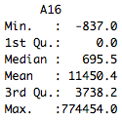
Goal
Predict
total of all triage level (total)
emergency department congestion light (light)
number of appointment of EM (A12)
number of waiting bed of EM (A15)
current longest waiting time for bed (mins) (A16)
Notes:
A16
Min. 1st Qu. Median Mean 3rd Qu. Max.
-837.0 0.0 695.5 11450.0 3738.0 774500.0

Slide 14
Goal
預測傷檢人數總和(Total)
預測急診部的雍塞燈號(light)
預測急診掛號人數(A12)
預測急診掛號人數(A15)
目前住院候床最大時間(分)(A16)
Notes:
A16
Min. 1st Qu. Median Mean 3rd Qu. Max.
-837.0 0.0 695.5 11450.0 3738.0 774500.0

Slide 15
Method
Tool: libSVM
Training : Validation
90:10, 80:20, 70:30, 60:40, 50:50
K-Fold Cross Validation
5 folds and 10 folds
Measurement
Morisita-Horn Similarity
Adjusted R Squared

Slide 16
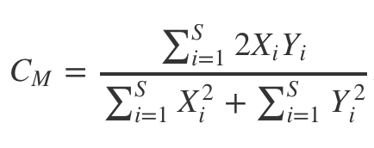
Morisita-Horn Similarity
S: Number of Unique Species
Xi: Reference Value of Species i
Yi: Predict Value of Species i
Morisita-Horn Similarity used to compare overlap among samples
Morisita-Horn Similarity could consider normalize Euclidean distance to [0,1]
Reference
Horn, H.S. (1966). “Measurement of “overlap” in comparative ecological studies”. American Naturalist, 100, 419-424.
Morisita, M. (1959). “Measuring of interspecific association and similarity between communities”. Memoirs of the Faculty of Science, Kyushu Univ., Series E (Biology), 3, 215-235.
Notes:
https://dspim.gitbooks.io/data-challenge-guide/content/morisita-horn_similarity.html

Slide 17
Feature Selection
date | date of record
tz | time of record [1]
Hospital_PK | code of hospital
Level | level of hospital [2]
PDR | patient doctor ratio
PBR | patient bed ratio
total | total of all triage level
Light | emergency department congestion light
A01~A03 | number of visits of Med., Surg., Ped. | A15 | number of waiting bed of EM
A04~A06 | waiting lists of Med., Surg., Ped. | A16 | current longest waiting time for bed (mins)
A07~A10 | number of 5 triage level | A17 | number of respirator using
A12 | number of appointment of EM | B01~B05 | Empty bed of different department in ICU
A13 | number of discharges by EM | B06 | number of waiting ICU
A14 | number of hospitalizations of EM | C01~C06 | number of surgery
[1] time of record, separate one day to six part: [0,4), [4,8), [8,12), [12,16), [16,20), [20,24)
[2] the level of first-aid capabilities ( 1 represent first-rate capabilities, 2 represent middling first-aid capabilities )
Notes:
medical, pediatrics, surgery
ICU: intensive care unit 加護病房

Slide 18
Quick Test
Random pick 3000 records to Train
Random pick 3000 records to Test
Predict light, total, A12, A15
Explore which feature is important
Feature
date -> month
tz -> number
Features
date | date of record
tz | time of record [1]
Hospital_PK | code of hospital
Level | level of hospital [2]
PDR | patient doctor ratio
PBR | patient bed ratio

Slide 19
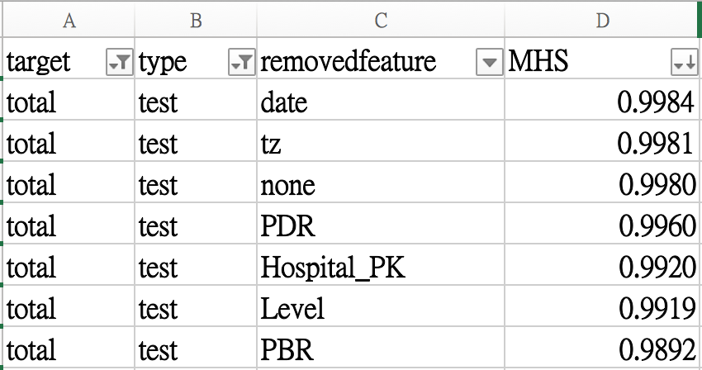
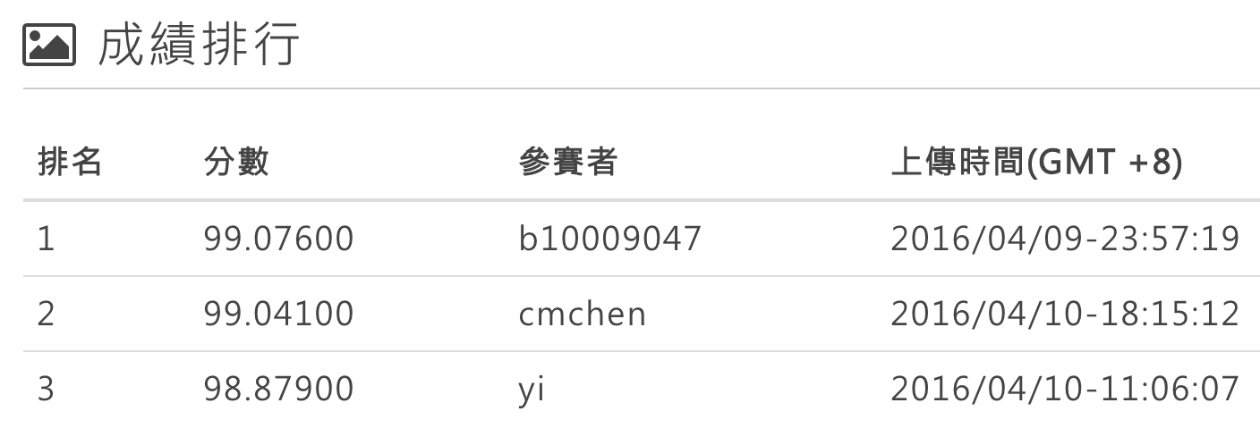

Quick Test
PDR | patient doctor ratio
PBR | patient bed ratio
Notes:
PBR is important for total

Slide 20
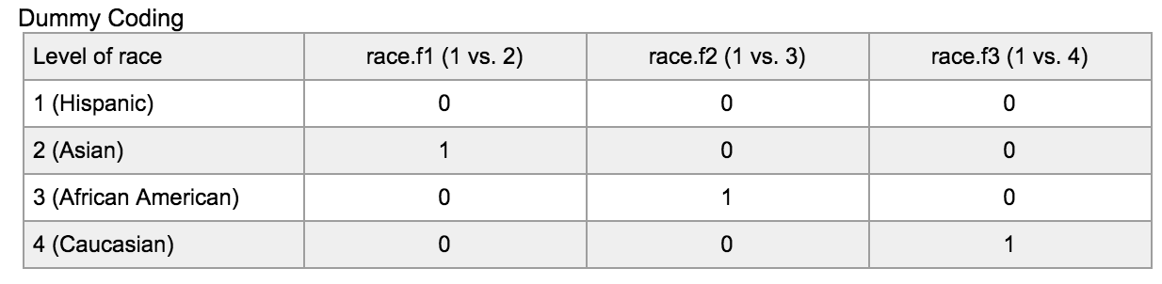
Dummy Variable
date | date of record
tz | time of record [1]
Hospital_PK | code of hospital
with R Package dummies
Notes:
change date, tz, hospital_PK to dummy variable
http://www.ats.ucla.edu/stat/r/library/contrast_coding.htm

Slide 21



Change Strategy
[
]
date | date of record
tz | time of record [1]
Hospital_PK | code of hospital
Level | level of hospital [2]
PDR | patient doctor ratio
PBR | patient bed ratio
total | total of all triage level
Notes:
use date, tz, hospital_pk, level to predict PDR, RBR
use date, tz, hospital_pk, level and prediction of PDR, RBR to predict total and other goal

Slide 22
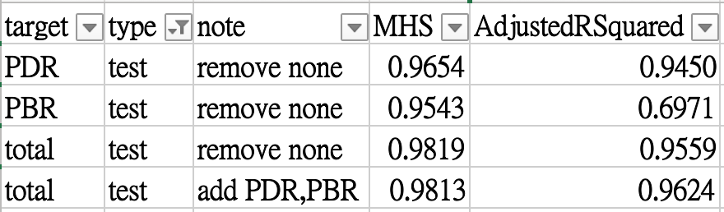
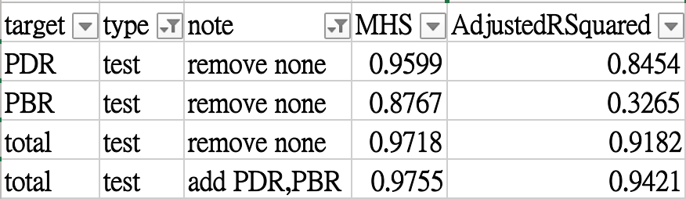
Result
Quick Test with Dummy Variable
Quick Test without Dummy Variable
Notes:
obviously the higher MHS of PDR, PBR, the total

Slide 23
Result
Quick Test with Dummy Variable
Quick Test without Dummy Variable
Notes:
with dummy variable the result is much better
the higher MHS of PDR, PBR, the total
but if the accuracy of PDR, PBR is not high enough, the prediction as feature will make result worse.

Slide 24

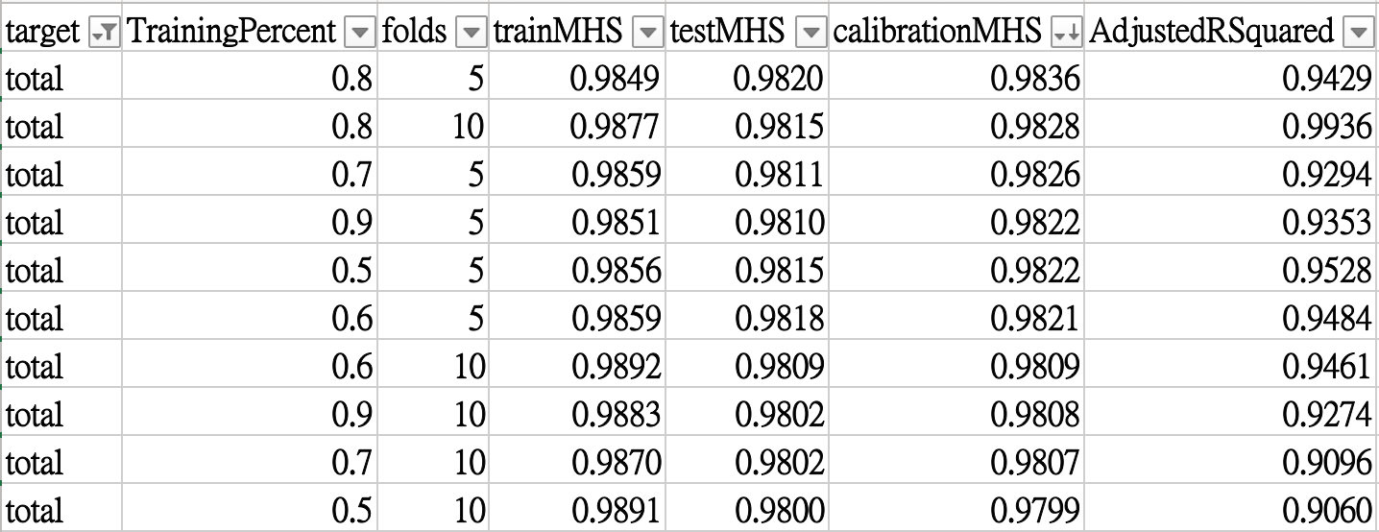
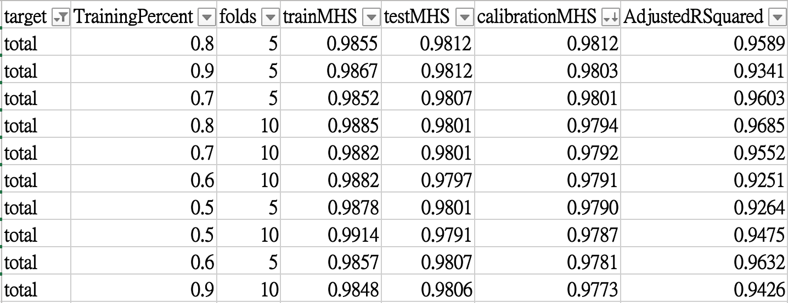
Result
Without prediction PBR, PDR as features
With prediction PBR, PDR as features
Notes:
So here is the sample problem what i mentioned before

Slide 25
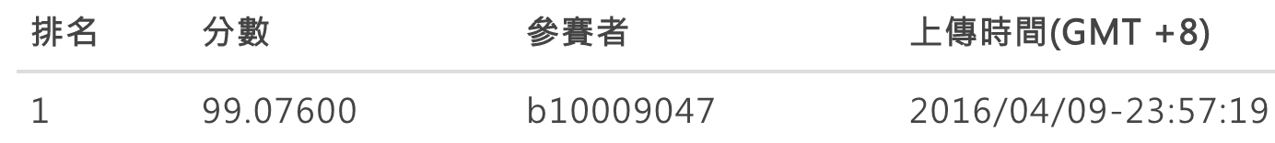
Result

Slide 26

Result
Quick Test without Dummy Variable
Final Result

Slide 27
Thanks for listening

